Slide 1



Dhiraj Hasija
(Associate Data Scientist)
Mock Project
SCALE | SPEED | INTELLIGENCE
Project title: Prediction of Credit card eligibility and Credit limit determination.
www.sigmoid.com

Slide 2
Contents:
Problem Statement and understanding
Key Insights from EDA
Key Steps in Feature Engineering
Types of Encoding
2 Best Algorithm and results
Credit Limit Strategy
Best numbers from the strategy
Appendix

Slide 3


Problem Statement and understanding
Context
ABC Payment Bank, a mobile only bank provides digital credit card within an hour to eligible users with a credit limit from $1000 to $8000. However, it is challenging to decide whom to approve the card and credit limit to be given.
Objectives
Determine the eligibility of users for approval
Determine the credit limit for every customer.
Data
Previous customer experience data provided by the bank + CIBIL Data.
Domain Knowledge:
Gross annual Income
Work history
Education history
Credit history
Number of credit accounts
Length of credit history
Type of credit
Given Data:
Education
Occupation
Work class
Date of birth
Capital gain
Capital loss
7. Address
8. Hours per week
9. Marital status
10. Email
11. Inquiry purp code
12. Asset code
13. Asset class cd
14. Portfolio type
15. Institute type
16. Account type
www.sigmoid.com
Sigmoid Private and Confidential- Not intended for copy or circulation
‹#›

Slide 4
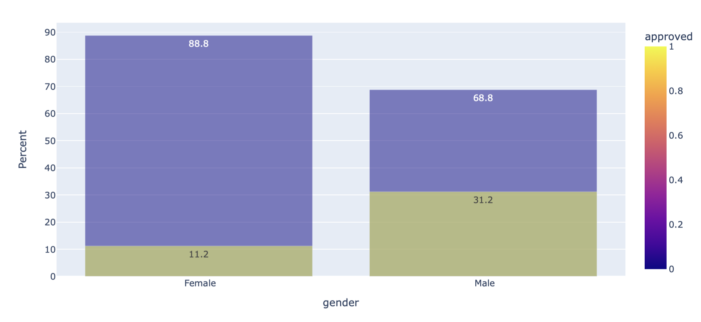
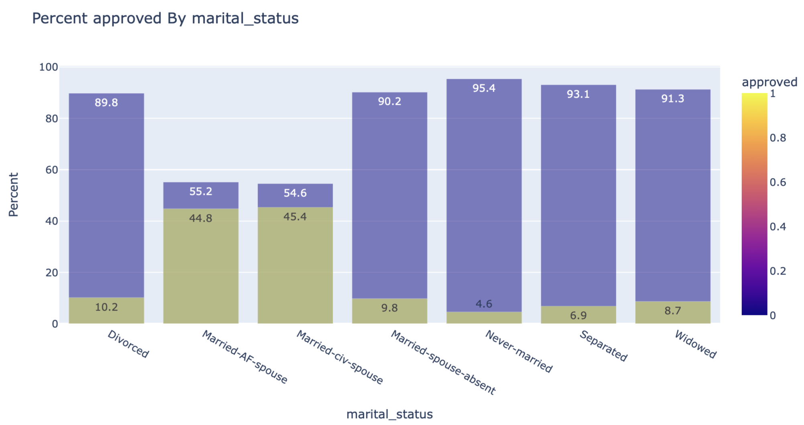
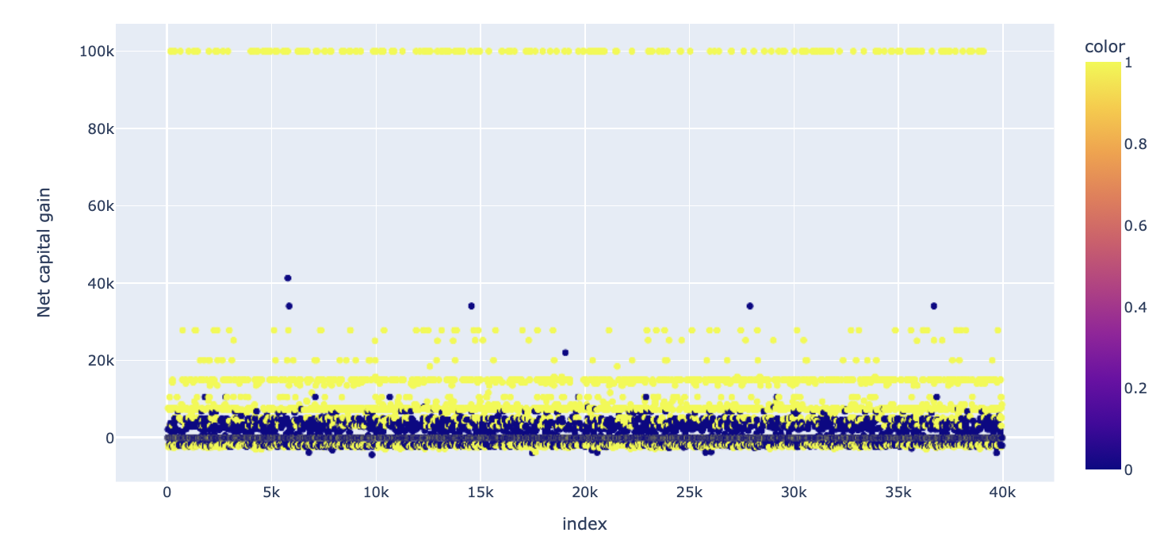
Key Insights from EDA
Age | Male | Female
0-25 | 13% | 22%
35-55 | 47% | 39%
Categorically correlated features
Marital Status: 0.45
Education level: 0.36
Occupation: 0.35
Age group: 0.31
Hours group: 0.27
Inquiry purpose code: 0.21
Age | 0-30 hrs | 35-50 hrs
0-25 | 41% | 47%
35-55 | 7% | 79%
Highly correlated continuous Features:
Net income (occ, age, edu): 0.47
Age : 0.27
Hours per week: 0.23
Net capital gain: 0.21
Education level ⬄ Occupation
Approval rate varies exponentially with education and occupation group
States and Zipcode => America.

Slide 5
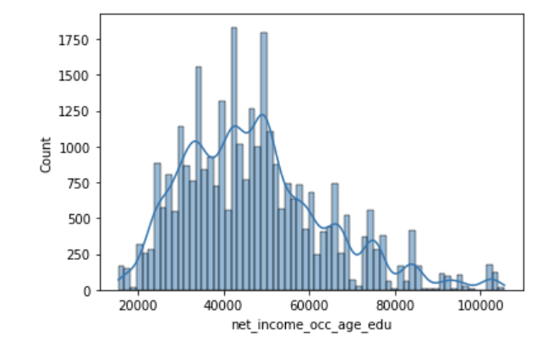
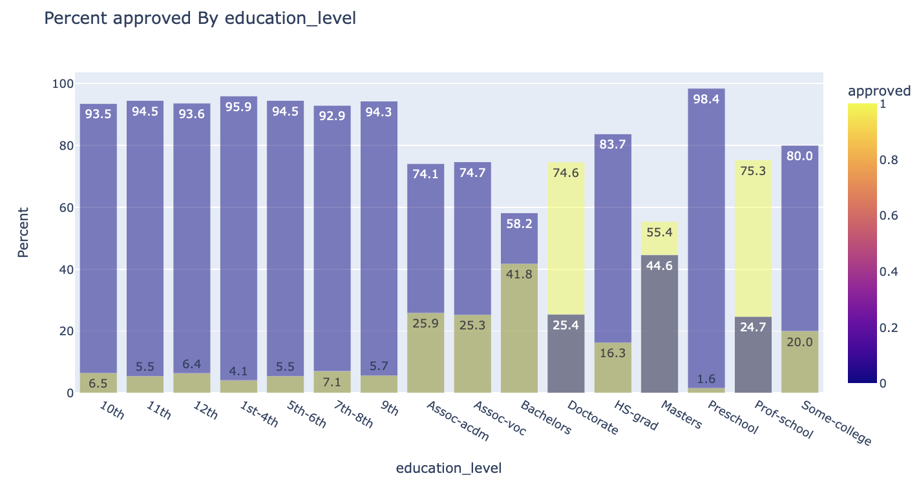
Key Steps in feature engineering:
Missing value imputation : Mode
Adding incomes:
Incomes based on …[1]
2. Net capital gain:
Capital gain – Capital loss
3. Education group:
4. Age from DOB
5. Converted CIBIL data features to categories
Age | 0.36
Education | 0.37
Occupation | 0.39
Relationship | 0.34
Marital status | 0.40
Workclass | 0.23
Net income : 0.47
* Other Feature like state, Zipcode, category columns were
Ignored due to lower correlation

Slide 6
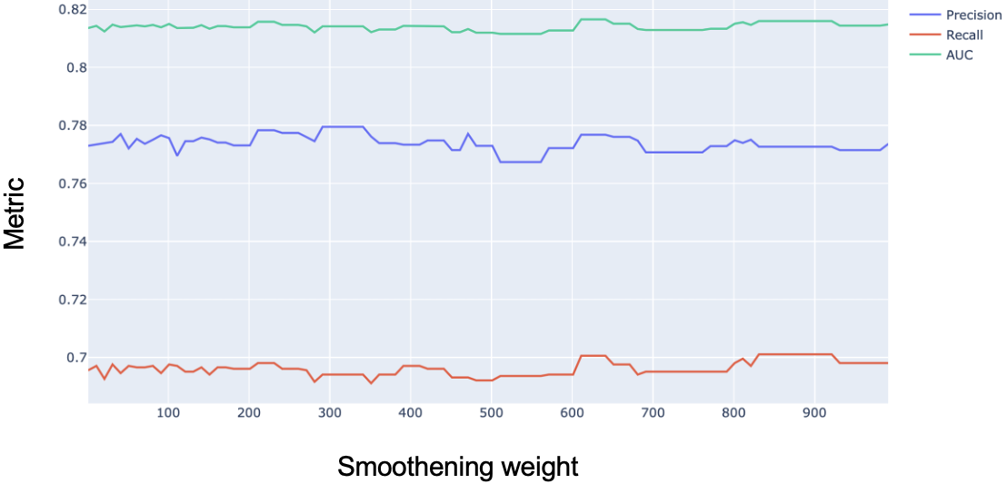
Type of encoding
Target encoding:
Account type, education group, asset code, inquiry purpose code, institute type, occupation, relationship, marital status, work class
Lesser number of features
Improves correlation between independent and dependent variables with its direct relationship
Faster learning
Can handle unknown values easily
Label encoding :
Gender
Binary class
One hot encoding:
Large number of features
Slows the model
Multicollinearity
* Other columns like income, Age, hours per week were added directly

Slide 7
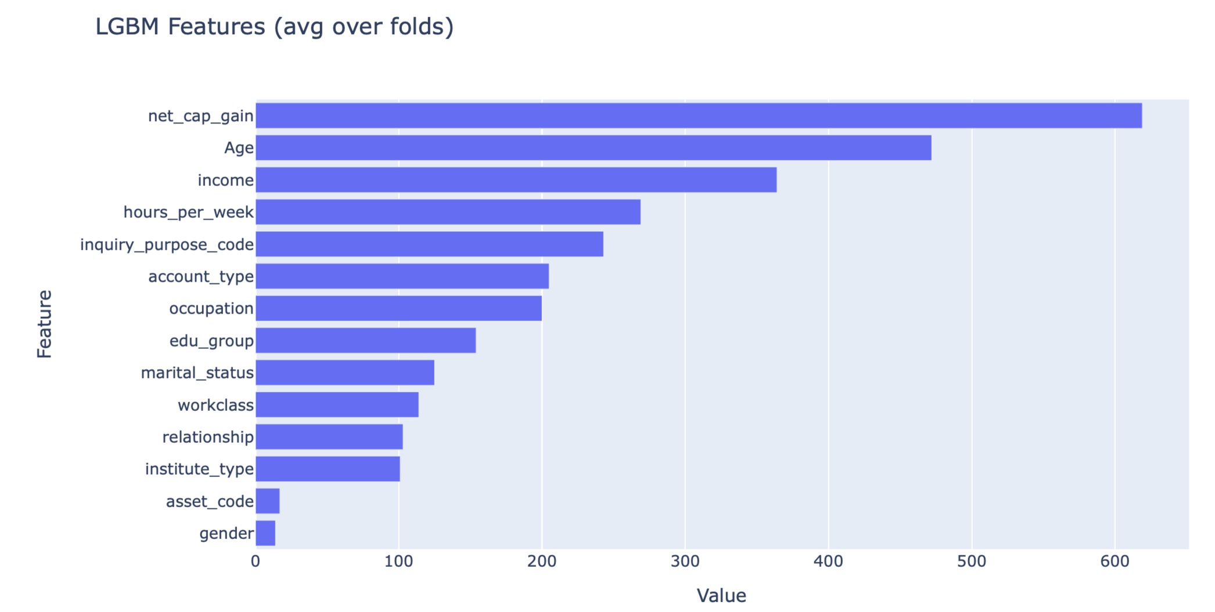
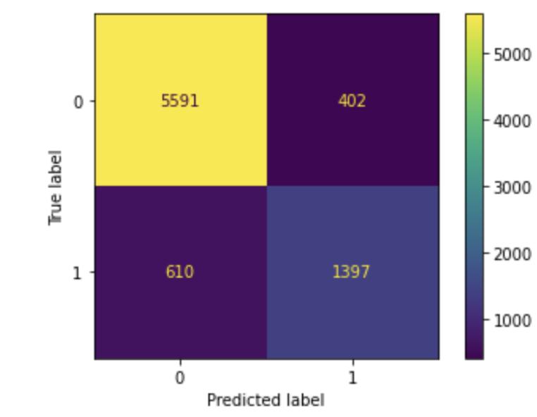
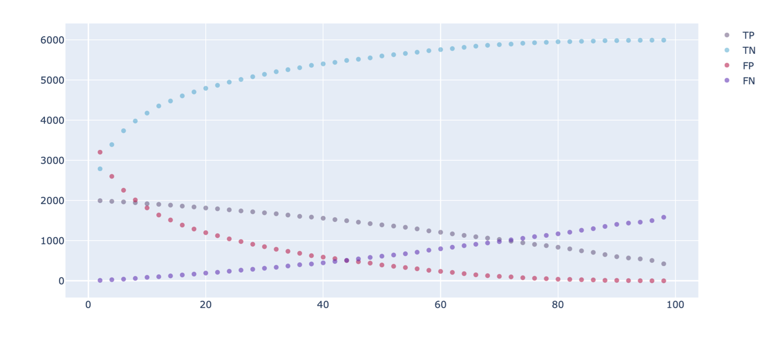
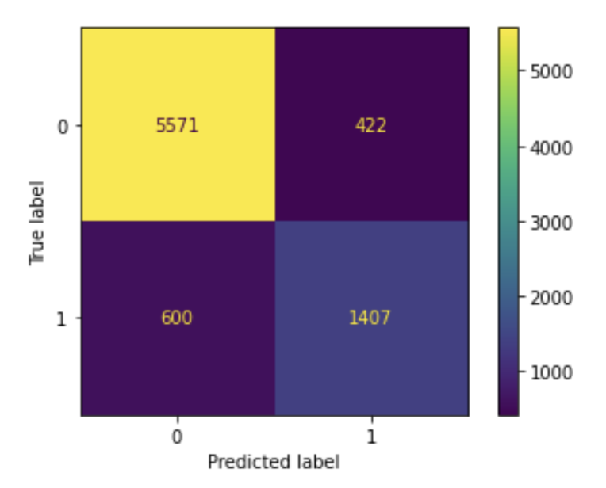
Best models and results:
Light GBM
Metric | Value
Precision | 77.7
Recall | 69.6
Auc_roc score | 81.6
XG Boost
Metric | Value
Precision | 76.9
Recall | 70.1
Auc_roc score | 81.4
Threshold = 0.42

Slide 8
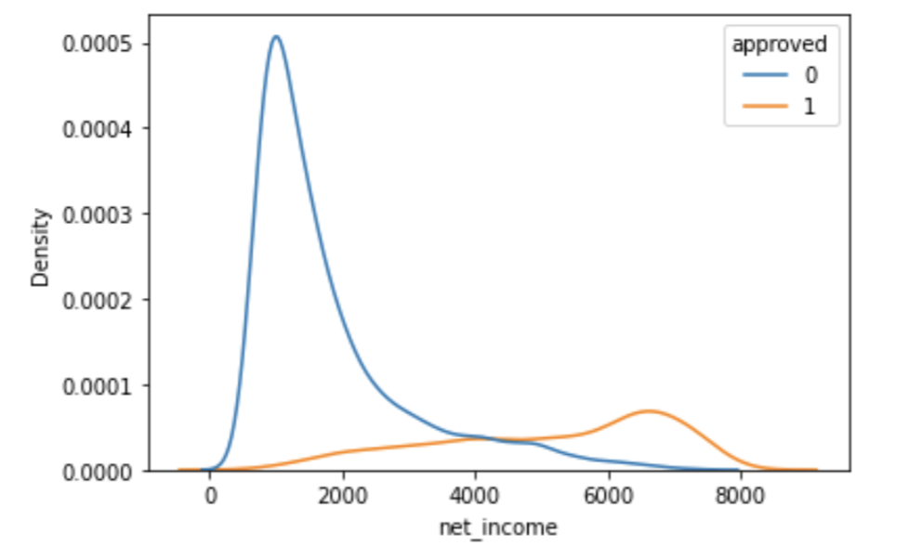
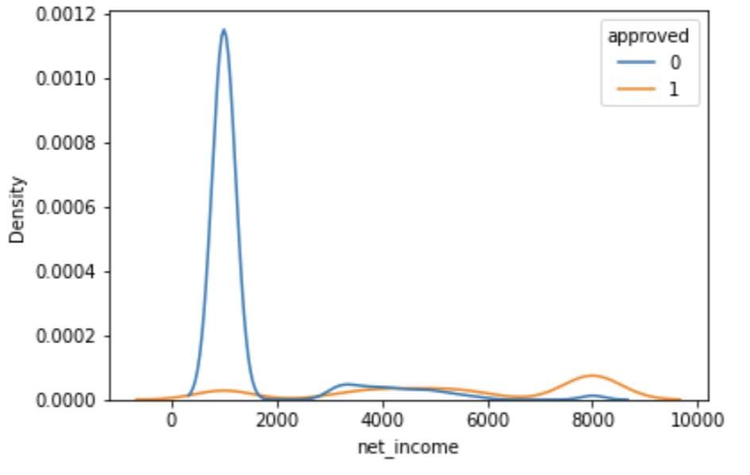
Credit limit strategy:
Credibility
Probability score from the model p_{score}
Credit
Income score i_{score} = Net_income ~ (0, 1)
Credit capacity
Tuned weights from feature importance
Credit score = ( 0.65*p_{score} + 0.35 * i_{score} ) *8000
w₁ | 10
w₂ | 540
w₃ | 200
w₄ | 70
w₅ | 50
w₆ | 110
w₇ | 80
To increase the robustness and the revenue
If credit < $3000 => credit = $1000
If credit > $5800 => credit = $8000
If credit in (3000, 5800) => rounded to nearest 500

Slide 9
Best numbers from the strategy
Revenue
$ 5.1M
Actual loss
$ 1.42M
Pseudo loss
$ 0.55M
51% of total credit
13% of total credit
5% of total credit
For validation set
Parameter | Value | % of total credit
Revenue | $ 9.9M | 53.3%
Actual loss | $ 2.9M | 15.9%
Pseudo loss | $ 0.39M | 2.1%
Error for the model (%): 13 %
** Extra error in the credit is caused by the minimum limit of $1000

Slide 10
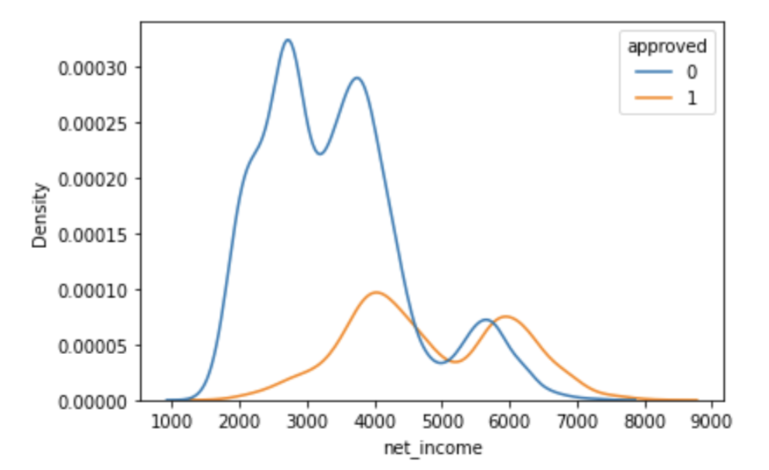
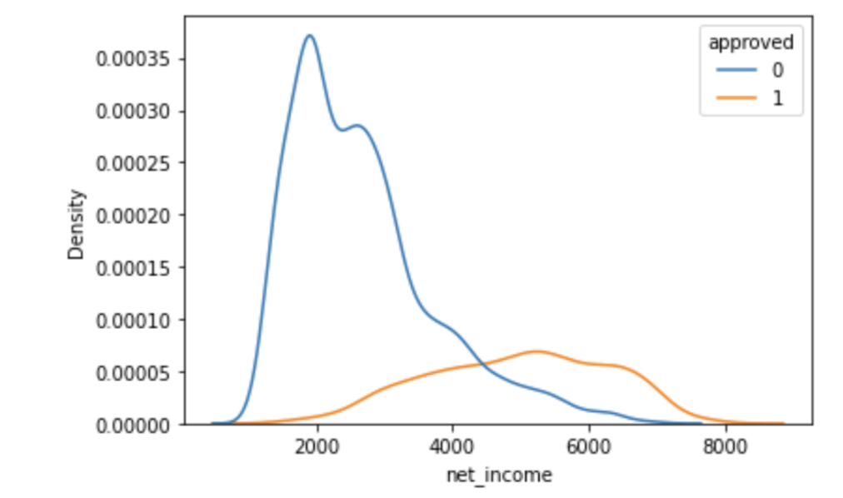
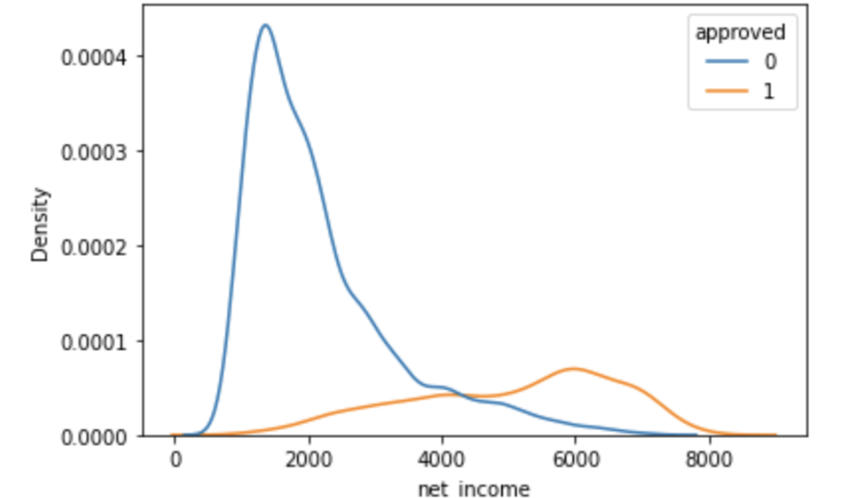
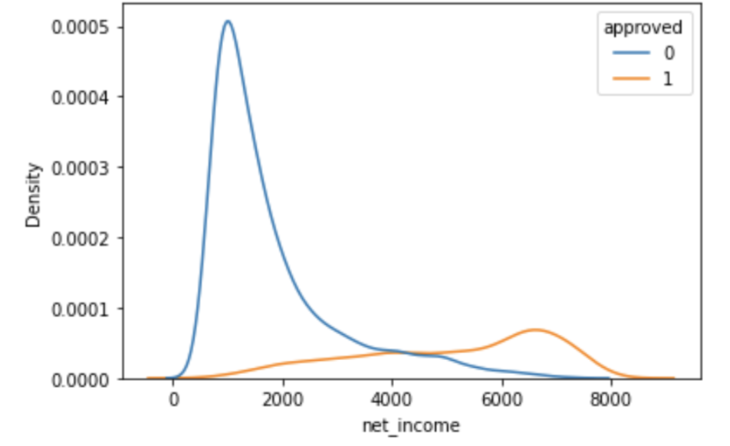
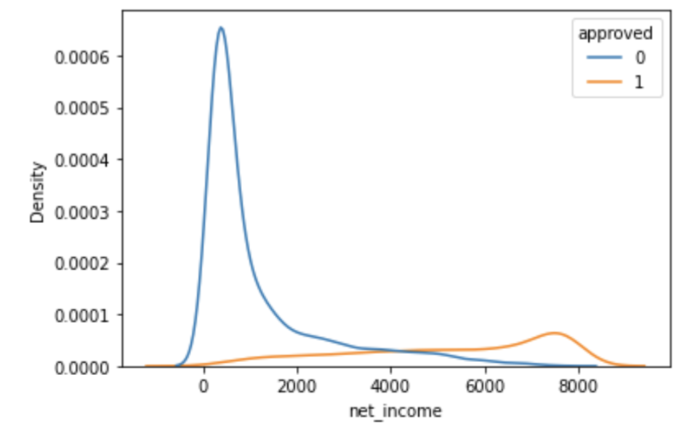
Appendix
Link for income data
[1] https://www.census.gov/data/tables/time-series/demo/income-poverty/historical-income-people.html
Variation of amount of credibility and credit capacity i.e. a
Pure salary, a = 1
70% Salary,, a = 0.7
50% Salary, a = 0.5
35% Salary, a=0.35
Pure prob, a = 0

Slide 11
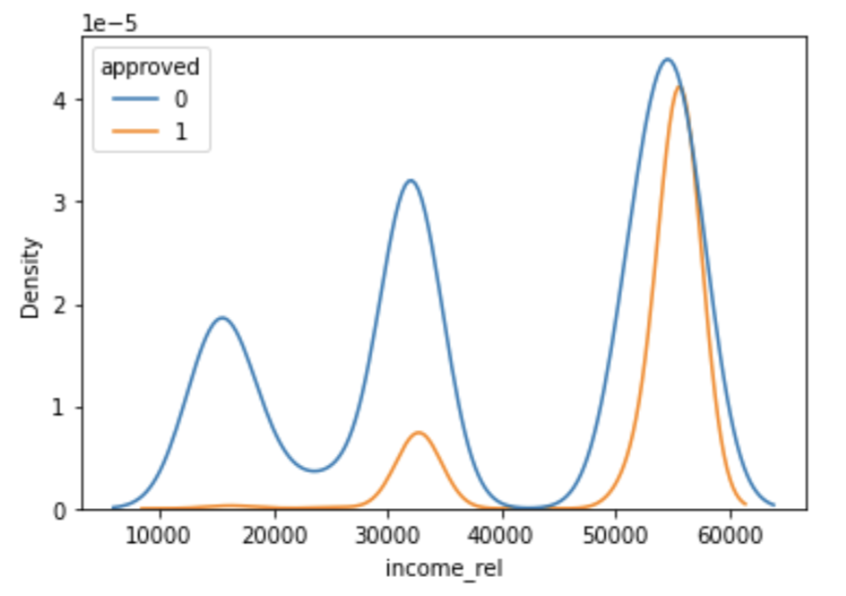
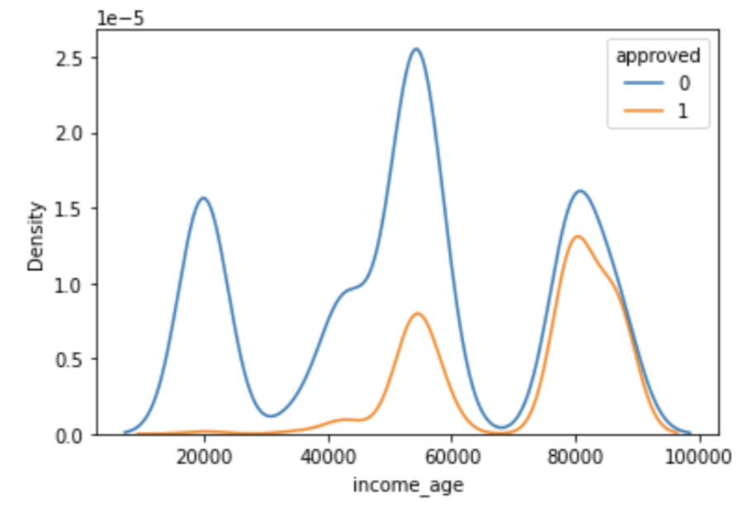
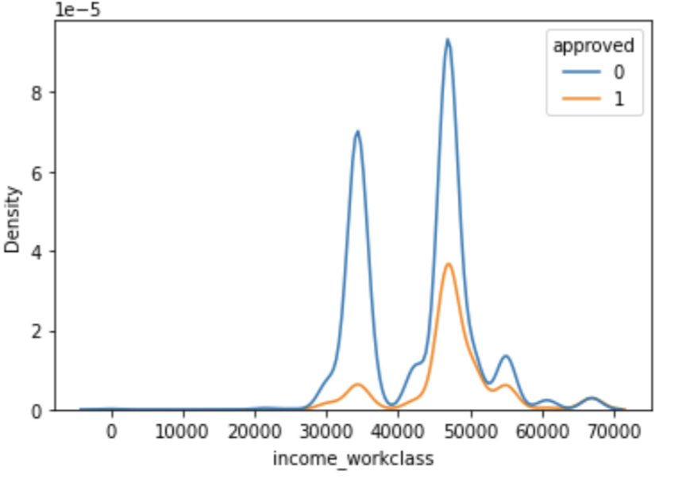
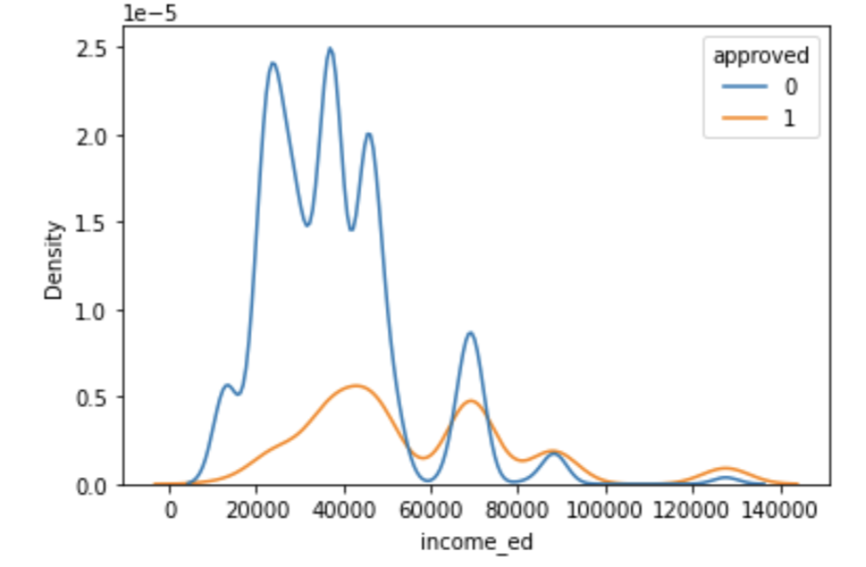
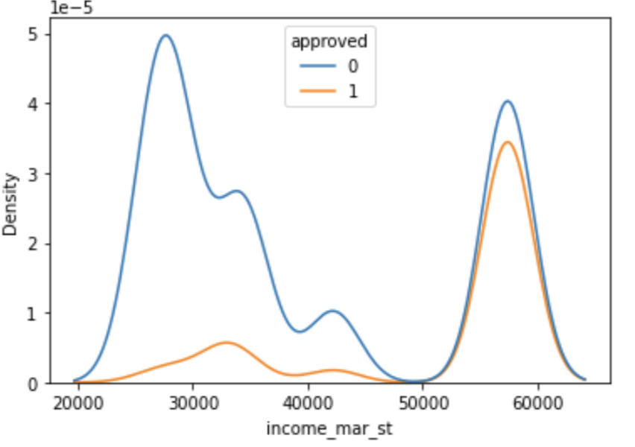
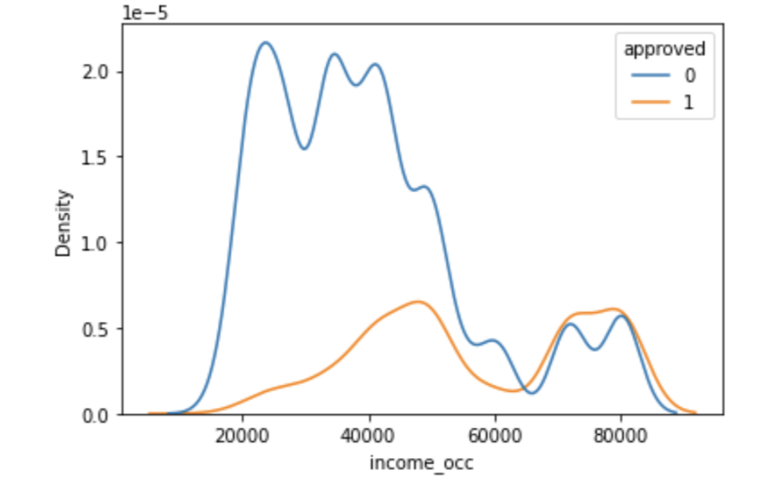
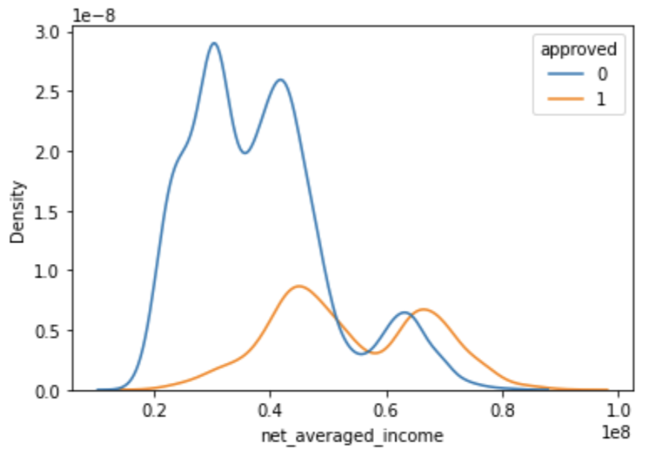
DISTRIBUTION OF INCOME WITH RESPECT TO DIFFERENT FEATURES
Distribution of credit
Distribution of Normalized weighted income
Distribution of income score
** Income score is weighted income with probability

Slide 12
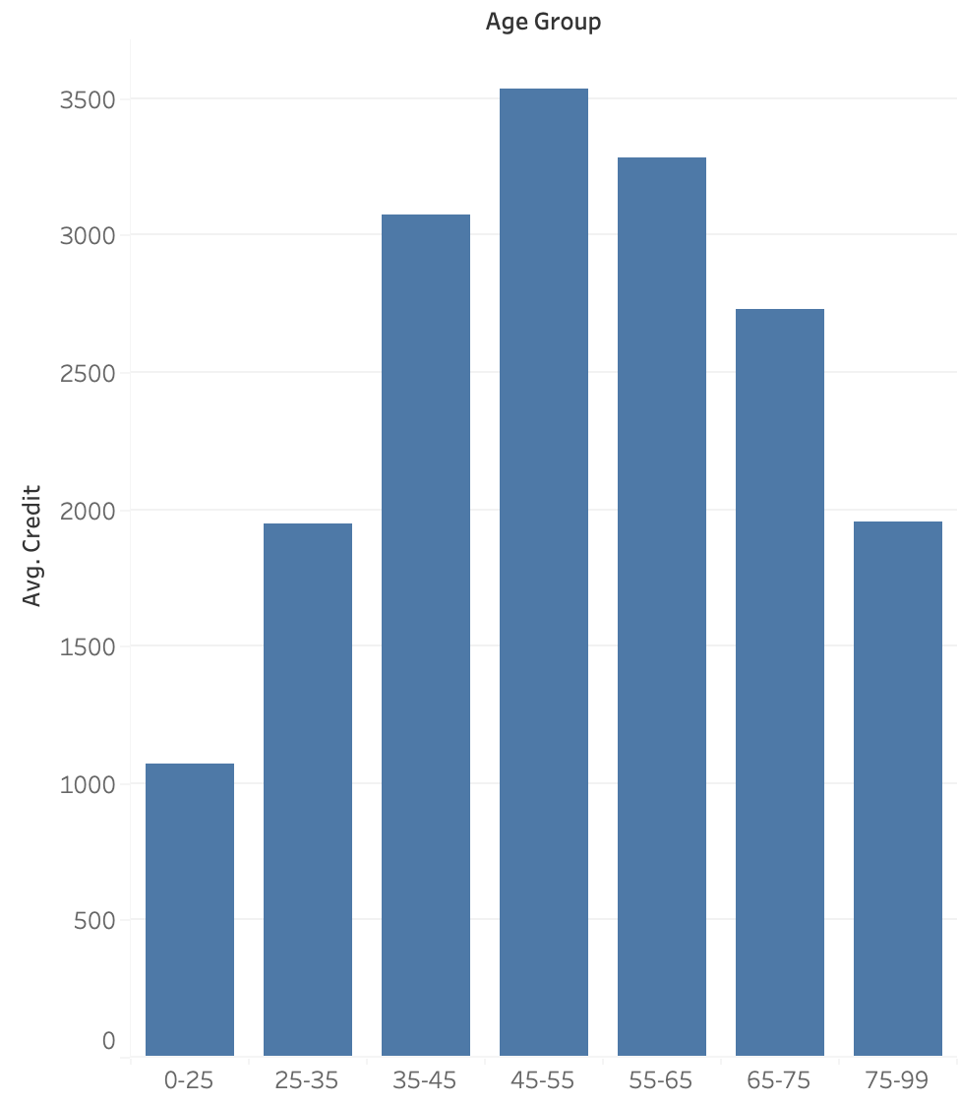
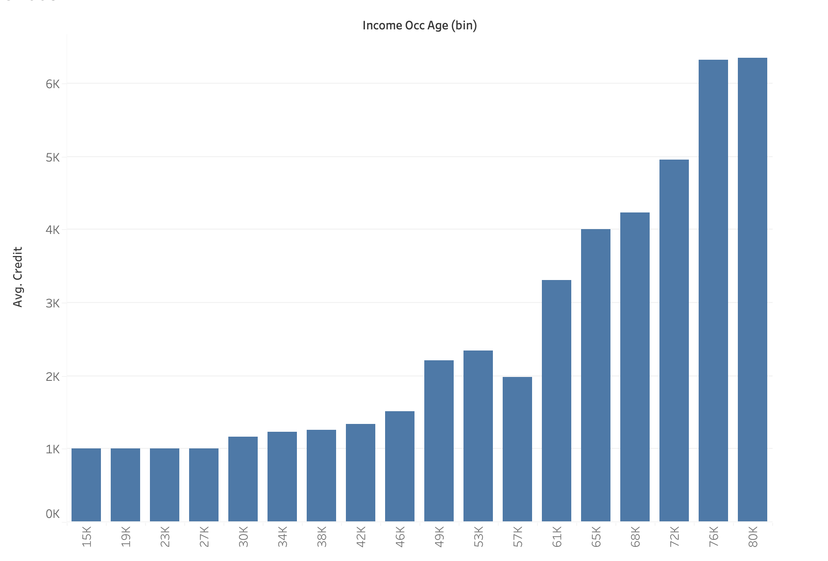
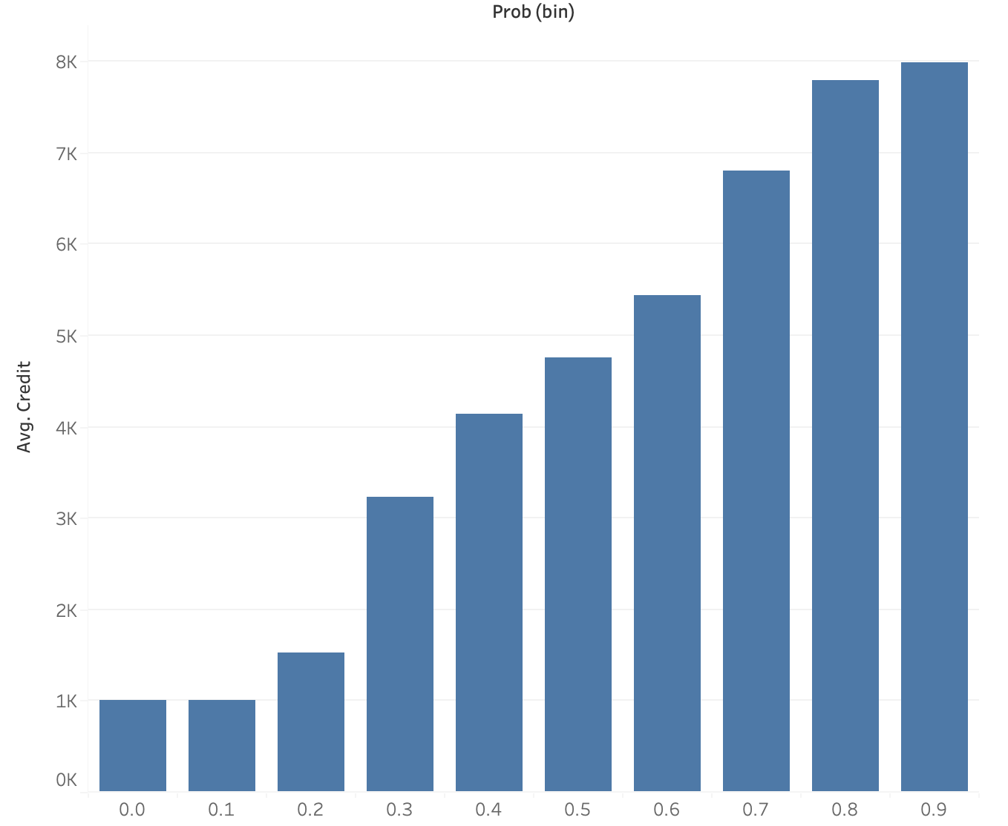
Distribution of credit with different parameters

Slide 13
STEPS IN THE PROJECT
1. Understanding of Data, various features and their categories
2. Gained domain knowledge
3. Performed UVA and checked where the data cleaning is required
4. Performed BVA and MVA to determine the relationship between features
5. Performed feature engineering iterations for categorical features
a. Tried combining categories
b. Creating separate columns for categories with very high or low approval rate
c. Combining features to create a new features.
6. Performed feature engineering iterations for continuous features
a. Binning and converting to categorical
b. Mathematical transformation to increase spacing between approved and non approved
c. Combining multiple features.
d. Adding new feature, salary and checking its correlation
7. Tried different encodings and tuned them.
8. Tried, Random forest, Logistic regression, XG Boost, Light GBM, Catboost
9. Tried combinations of different categorical and continuous features for making the model.
10. Hyper parameter tuning
11. Selected threshold.
12. Different credit limit strategies
Based on approval.
Based on threshold, two threshold
Based on probability + feature
Based on income
Based on income and probability
13. Creating the prediction pipeline.

Slide 14
Thank you

